Slide 1
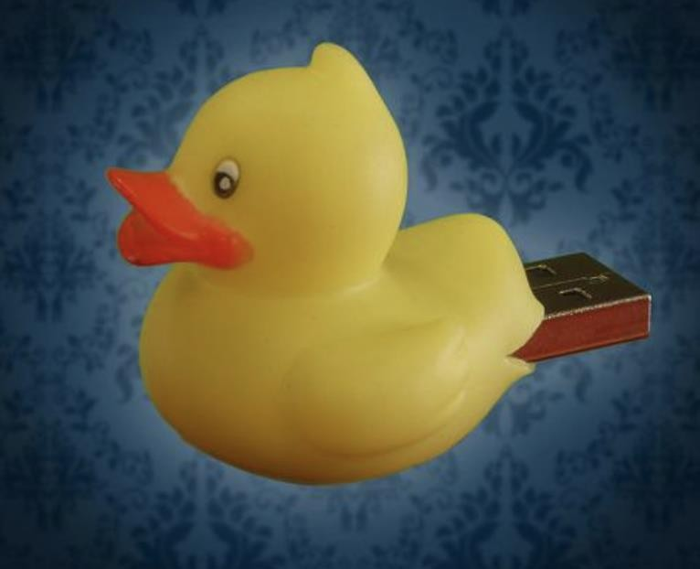
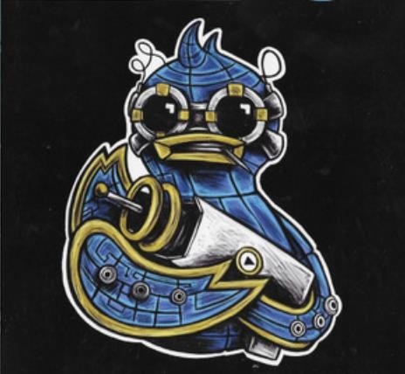

AREEB HUSSAIN
ASYLBEK BUGYBAY LOLA UEDA
DETECTING BAD USB ATTACKS, PART II
FIG. 1, FIG.2

Slide 2

WHAT IS RUBBER DUCKY?
TEXT
▸ The USB Rubber Ducky - Human Interface Device (HID: keeyboard, mouse, joystick)
▸ Injects keystroke at superhuman speed into a system
Fig. 3
▸ Based on an AMTEL 32bit chip and SD card
▸ Pretends to be a USB keyboard
▸ The script language - Rubber Ducky Script
▸ No anti-virus, firewall detection possible

Slide 3

THE USAGE OF RUBBER DUCKY (MUST HAVE PENT-TEST)
▸ Learning from experiences of many hackers around the world
▸ Hacking for testing, finding security valnerabilities
Fig.4
▸ Automation & Backups
▸ Run a malicious ccode: install backdoors, capture credentials, drop malware, exfiltrate documents

Slide 4

LEGAL ISSUES
▸ 202 Violation of the privacy of written word
▸ 202a Data espionage
▸ 202b Phishing
▸ 202c Acts preparatory to data espionage & phishing
▸ 202d Handling stollen data
▸ 203 Violation of private secrets
▸ 204 Exploitation of the secrets of anotheer
▸ 303a Data tempering
Fig.5
▸ 303b Computer sabotage

Slide 5
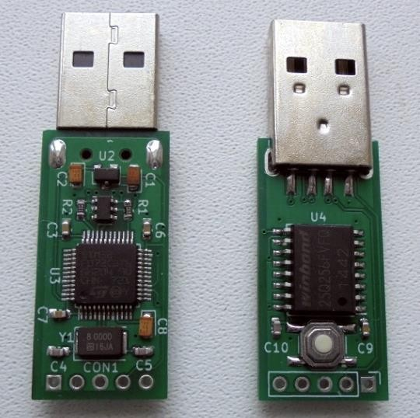
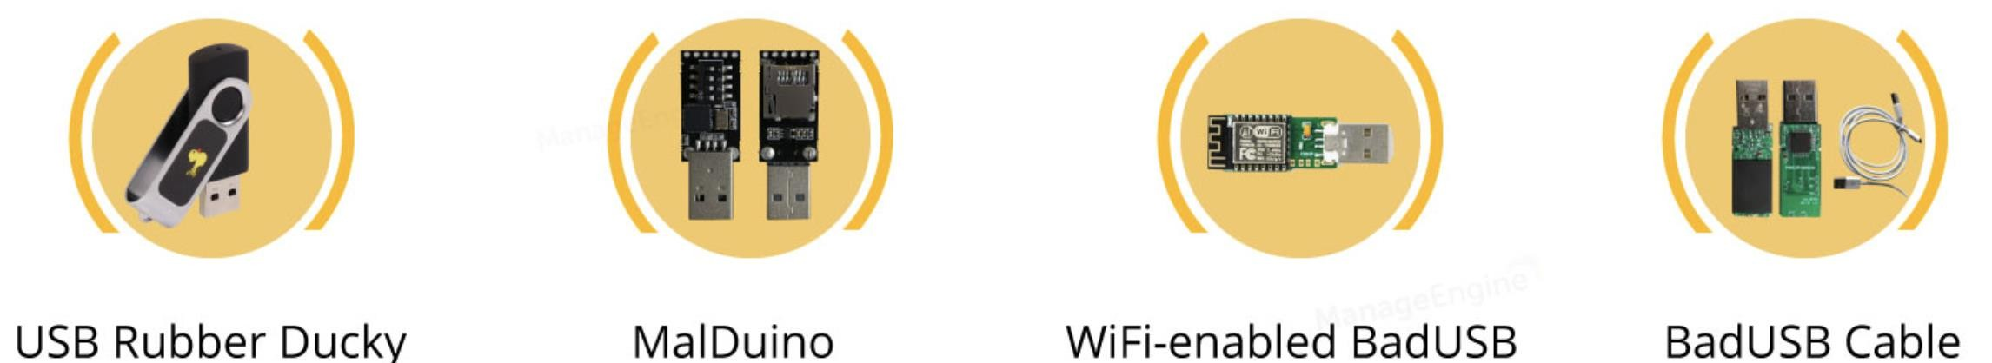
THE RUBBER DUCKY PARTS & ALTERNATIVES
▸ MicroSD card: all the payloads are saved here
▸ MicroSD-to-USB adapter: a simple plastic dongle mount the SD card to machine
that used to
▸ Mini “keyboard” adapter: a silicon chip, the main part that sends the keystrokes to a
computer, to insert a micro SD card
Fig.6

Slide 6
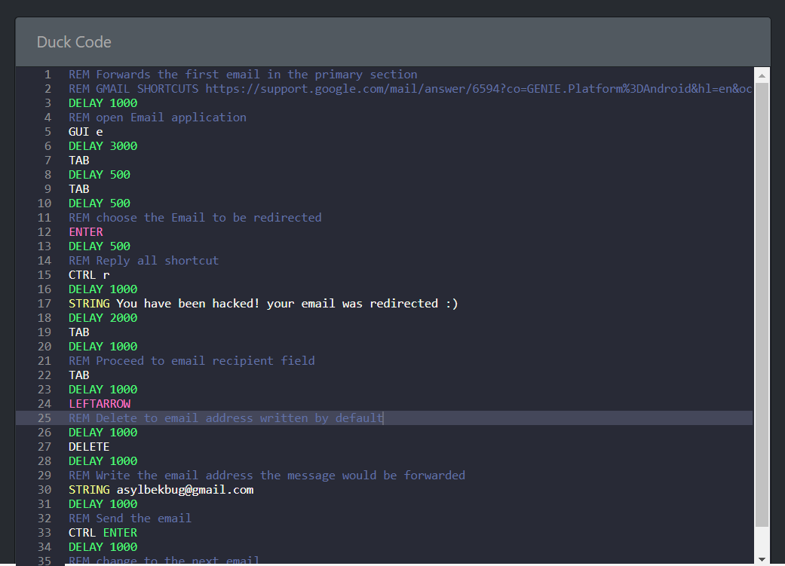
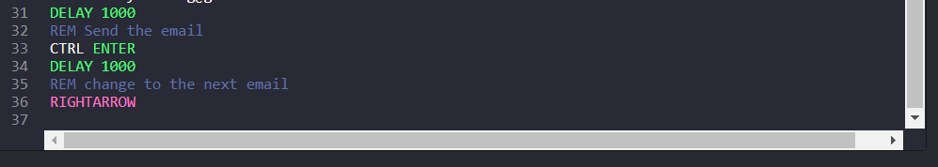
Full command:

Slide 7
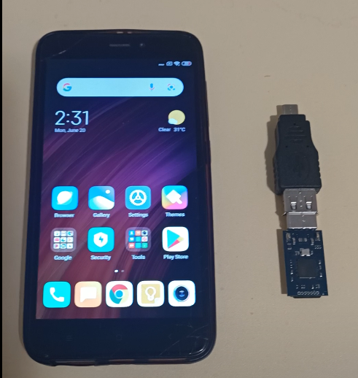
Initial layout

Slide 8
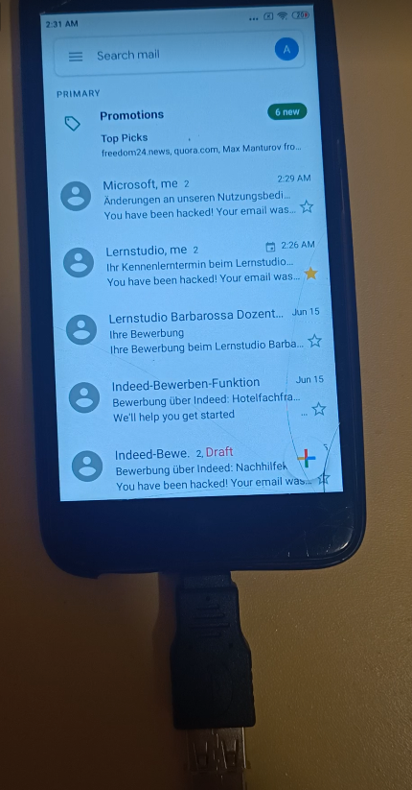
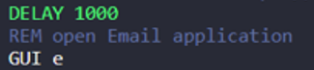

Slide 9
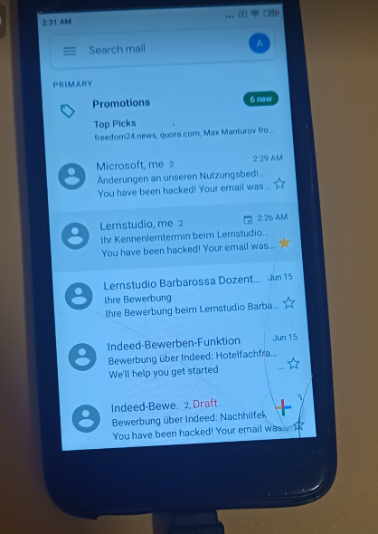
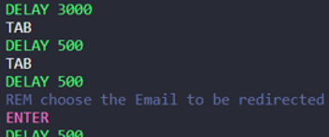

Slide 10
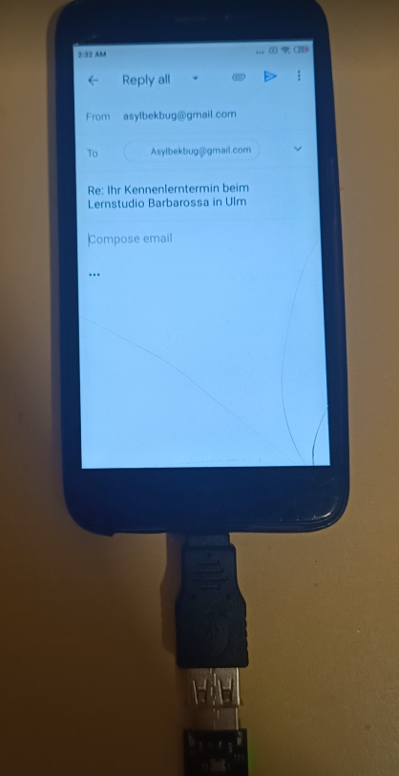
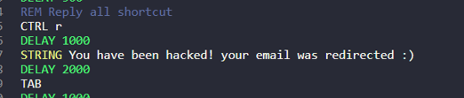

Slide 11
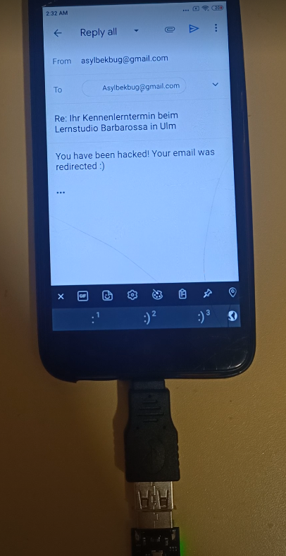

Slide 12
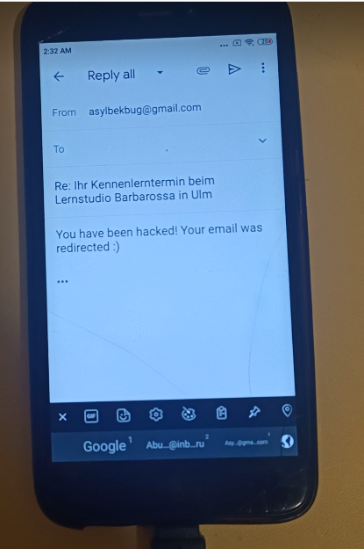
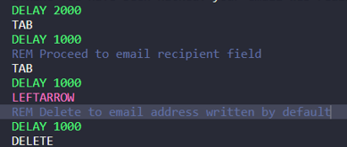

Slide 13
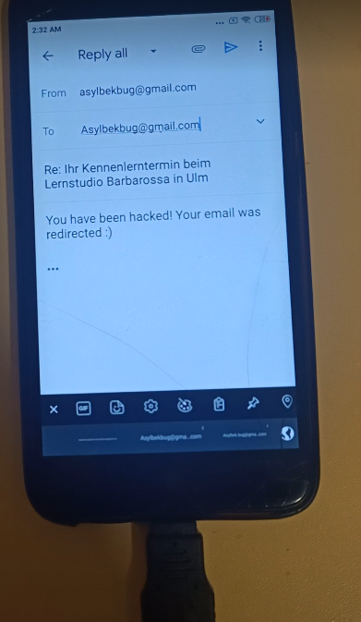

Slide 14
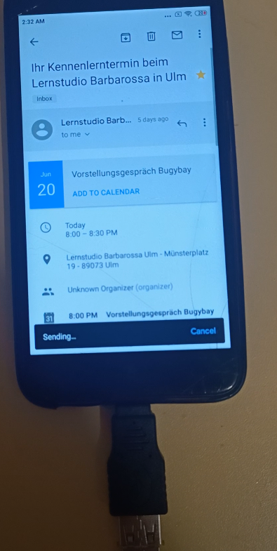
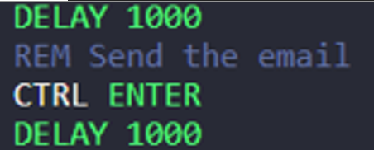

Slide 15
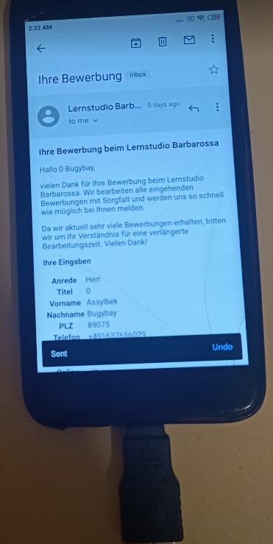
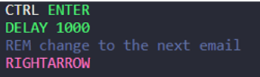

Slide 16
REFERENCES
▸ URL: https://www.hackmod.de/USB-Rubber-Ducky-Book-1 , Fig.1
▸ URL: https://www.crazyws.fr/tag/usb-rubber-duck/ , Fig.2
▸ URL: https://blog.teamascend.com/rubber-ducky , Fig.3
▸ URL: https://www.turkhackteam.org/konular/usb-rubber-ducky-nedir-ne-ise-yarar.1941282/ , Fig.4
▸ URL: https://www.un.org/securitycouncil/ctc/content/legal-issues , Fig.5
▸ URL: https://www.manageengine.com/device-control/badusb.html , Fig.6
▸ URL: https://hackaday.com/2019/07/24/an-open-hardware-rubber-ducky/ , Fig.7

